Slide 1
Combing Low-Dimensional Wavelets Features and Support Vector Machine for Time Series Classification
Team: Karnargus
William Argus & Karndeep Rai-Bhatti

Slide 2
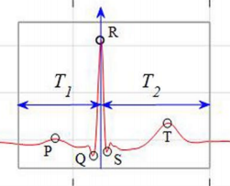
Problem Summary
Given a segment of time series data, quickly and accurately classify the data
Medical Data - ECG
Sensor Data - Gait
Environmental Data - Driving Surface
Classification of time series data
Manual analysis is inefficient, laborious, and error prone
Framed as a Pattern Detection problem
Small training set
Apply technique to parallel problems
Notes:
The goal of out work …
A key example is medical data ecg - patients heart monitor
Train on 5 minutes of data and robustly and accuratly predict from that point forward
This solves a problem where analysis is typically …
Frame our problem ...
Want to develop this classification technique in the context of the ECG problem and apply it the parallel problems in other disciplines
Hint at gait and data

Slide 3
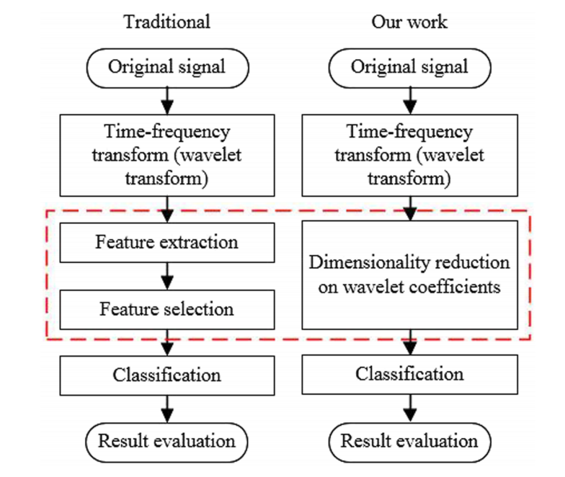
Other Approaches: Pro and Con
Acharya et al.
Bior Wavelet Transform > sub-band fuzzy entropy & log-energy > Binary SVM classification
Gabbouj et al.
Wavelet Transform> PCA> FeedForward NN
Min et al.
PCA, LDA, ICA > classification with NN, SVM classifiers, PNN
Pro: Consistently Get high accuracy ~ 99%
Common Problem: Classification schemes optimized/trained across whole database
Underperform in realistic setting where only prior data is available
Notes:
With that in mind, there are 2 notable approaches to this problem using wavelets

Slide 4
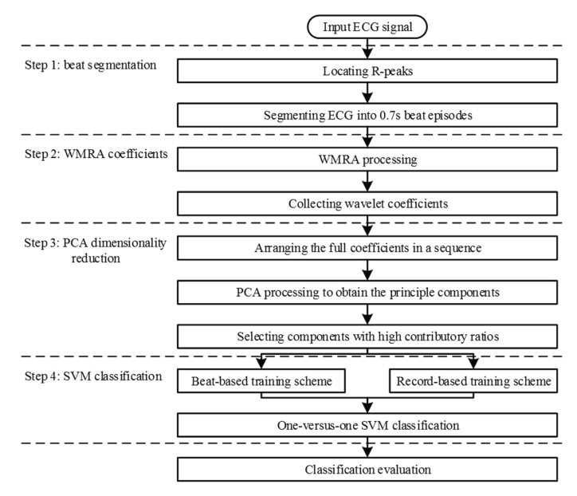
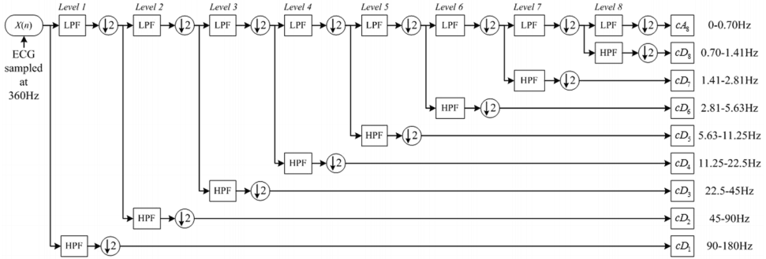
Proposed Approach
Classification Scheme Proposed by Liu et al.
8 level WMRA using bior(6,8) wavelets
PCA
Record-Based Analysis
10 fold CV
Notes:
Given an ECG signal, they individually segment each beat
Sent to 8 level FB
10 fold cross validation

Slide 5
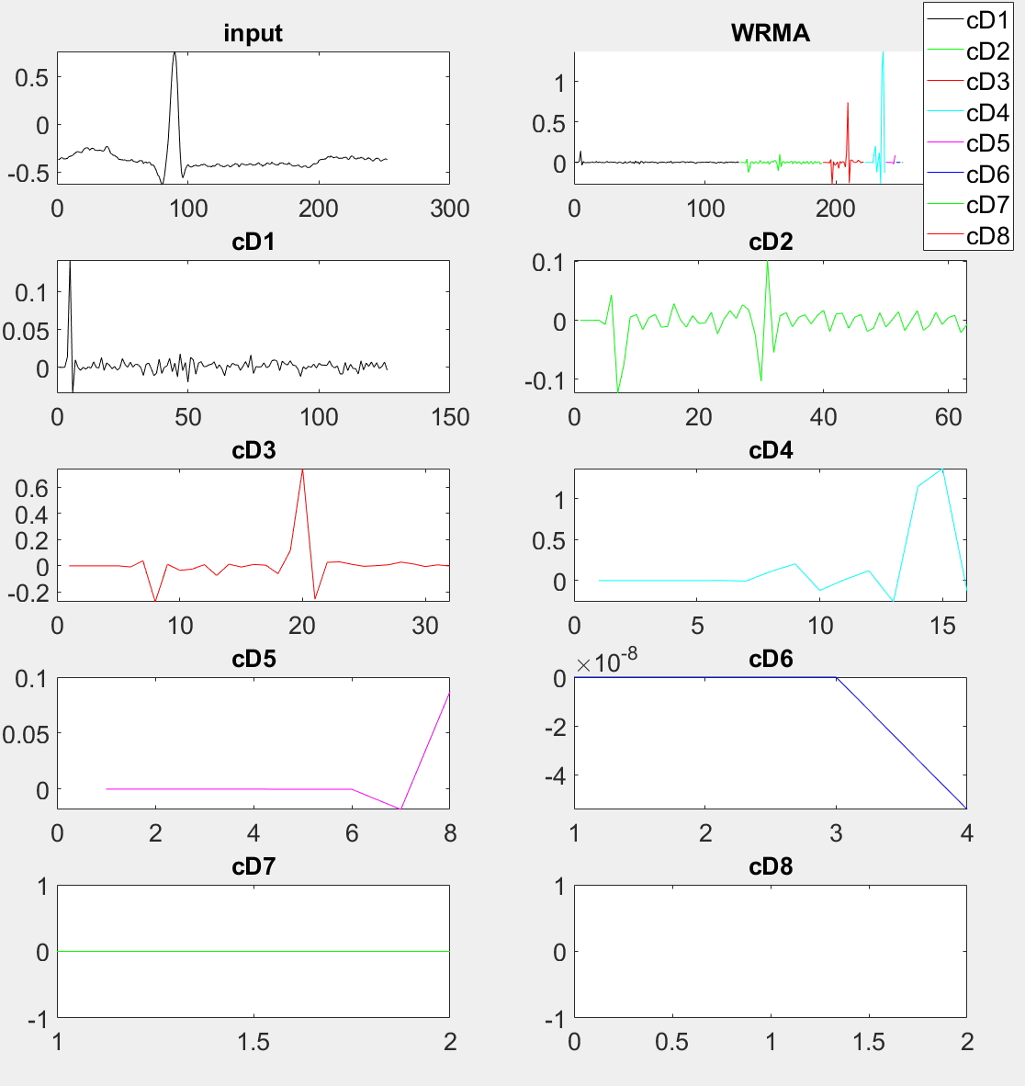
Preliminary Result
Segmentation
WMRA
Linear SVM
Without dimensionality reduction and
thus simpler SVM: 83% classification accuracy

Slide 6
Project Plan
Data
Implement Dimension Reduction
Principal Component Analysis
Switch from Linear to C-Support Vector
C-Support Vector Classification
Better hyperplane construction
Wavelet Optimization
Optimize the the wavelet used for WMRA
Maximize Accuracy
Apply Method to datasets
WMRA
Optimization of Ho and Fo
Dimensional Reduction
Cost Function
SVM
Prediction

